Slide 1
How to Keep Your Plants Alive: A Technological Adventure
Kaitlyn Pounds and Jillian To
Group 1

Slide 2
Overview/Goal
Smart Plant Watering System
Monitor and display the moisture level of the soil
Monitored over the internet through Thingspeak
Administer water when moisture is too low
System will keep track of the water available to be dispensed
LED indicates if water must be refilled
Moisture threshold can be calibrated with a button on the device
Monitor temperature
LED indicates when temperature is too high

Slide 3
Functional Block Diagram
Servo
Analog
Capacitive Soil Moisture Sensor
PWM
WiFi
Analog
Thingspeak
MSP430
Temperature Sensor
Analog
Analog
Analog
Blue LED
Analog
Push Button (Water level reset)
Push Button (Calibrate moisture threshold)
Red LED

Slide 4
List of Equipment & Design Cost
Part | Cost ($)
PCB | 5
PCB components (resistors, capacitors, etc.) | 0
Capacitive soil moisture sensor | 0
Servo | 0
Red LED | 0
Blue LED | 0
Push buttons (2x) | 0
Temperature sensor | 0
ESP-01 WiFi module | 0
Total | 5

Slide 5
Timeline
 | Week of: | 2/28 | 3/7 | 3/14 | 3/21 | 3/28 | 4/4 | 4/11 | 4/18 | 4/25
Task: | Project proposal | x
 | Part ordering | x | x
 | Moisture sensor programming |  | x | x
 | Servo programming |  |  |  | x
 | Temperature sensor programming |  |  |  | x
 | WiFi module programming |  |  |  |  | x | x | x
 | Combining programmed parts |  |  |  |  |  |  |  | x | x
 | Final presentation |  |  |  |  |  |  |  |  | x
 | Schematic design |  |  |  | x | x
 | PCB design |  |  |  |  |  | x
 | PCB assembly |  |  |  |  |  |  |  |  | x

Slide 6
Progress
Completed Tasks
Moisture measurement
Servo functionality
Temperature measurement
WiFi connectivity
Indicator LEDs
Create PCB
Solder components onto PCB
Remaining Tasks
Add fan
Add piezo buzzers
Create CAD Casing
Make measurements available on LCD
Optimize program
Connect multiple moisture sensors and servos to microcontroller to manage multiple plants

Slide 7
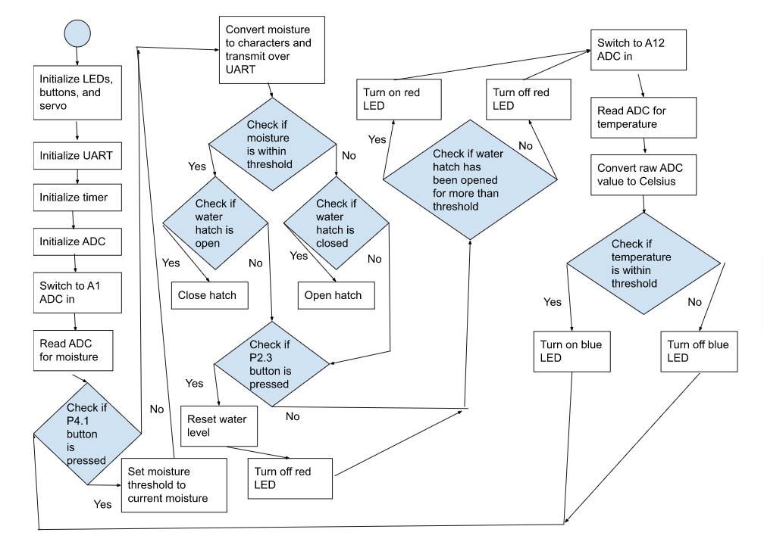
UML Activity Diagram

Slide 8
Demonstration

